Slide 1
Capstone Project: Improving Insurance Claims Management
Accelerating claims approval for BNP Paribas Cardif
By Lisa S Ang
Mentor: Anirban Ghosh

Slide 2
Introduction: Insurance Claims Management
Effective claims management is a critical aspect of a functioning insurance provider
Need to balance:
Claim costs
Risk management
Client satisfaction
Claims handling costs
Goal ➔ Maximize efficiency of the claims process
Reduce the manual evaluation of claims as much as possible

Slide 3
Automate Claims Handling
Claims process can be quite similar across industries
Client files claim > Evaluate > Process > Remit payment (or not)
BNP Paribas Cardif Kaggle competition
Large provider of personal insurance policies
Identify which claims can be approved early in the proceedings, and which require more verification

Slide 4
Data
Downloaded from Kaggle
Database provided: train.csv and test.csv
Project aim:
Generate a model to predict the probability of accelerated approval for each claim in test.csv

Slide 5
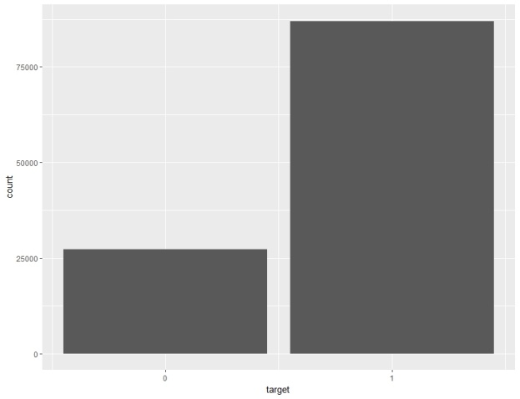
Explore the Dataset
train.csv ➔ 114321 observations of 133 variables
131 independent variables, target and ID
test.csv ➔ 114393 observations of 132 variables
131 independent variables and ID
Dependent variable ➔ target
1: accelerated approval, 0: needs more information
131 independent variables
19 categorical, 112 numeric
Descriptive column names are not provided, only generic (v1, v2, v3 etc)
Difficulties for feature engineering
Moderate class imbalance ratio for dependent variable(target) of 3:1
No empty rows
Many missing variables

Slide 6
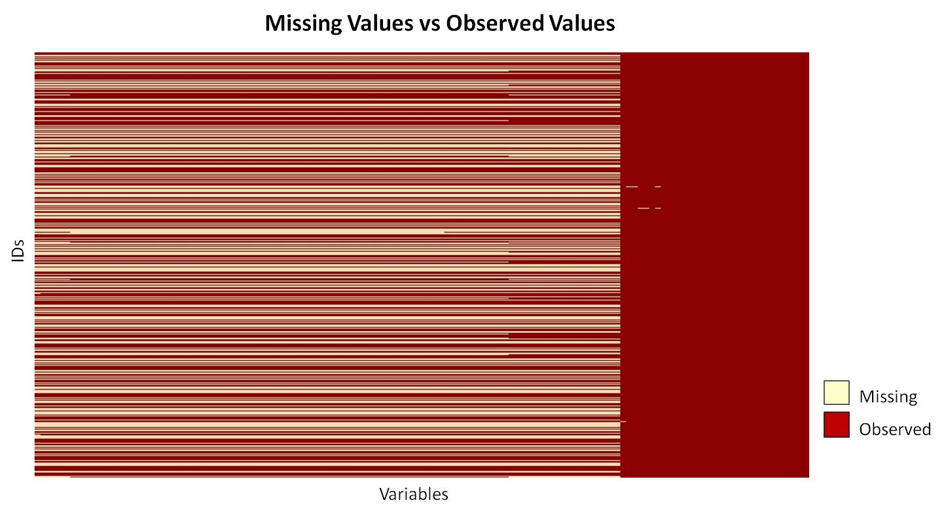
Data Preparation
Data cleaning
Partitioning
Training set was split 50:50 into training and validation sets, maintaining same ratio of dependent variable (target)
Missing values
100 columns with > 25% missing values
Missing values could have predictor capabilities
Imputation is difficult because column names are not provided
Removed columns with > 25% missing
Reduced training set to 57160 obs.
of 32 variables, including target

Slide 7
Data Preparation
Split into categorical and numeric for separate processing of outliers and remaining missing values
Categorical variables
Remove variables with > 15 levels
Columns with ≤ 5% missing ➔ replace NA with most common level
Columns with >5% missing ➔ replace NA with new level “missing”
Numeric variables
Outliers defined as < 5th or > 95th percentile
Replace outliers with original mean
Replace missing values with column median

Slide 8
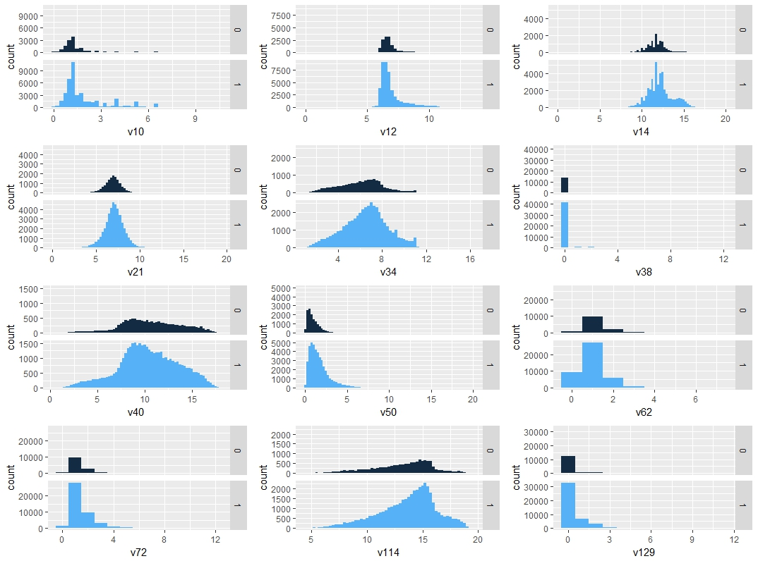
Data Exploration: Histograms
Distribution of numeric variables:
v10, v12, v14, v21, v34, v38, v40, v50, v62, v72, v114, v129
Possible zero or near-zero variance

Slide 9
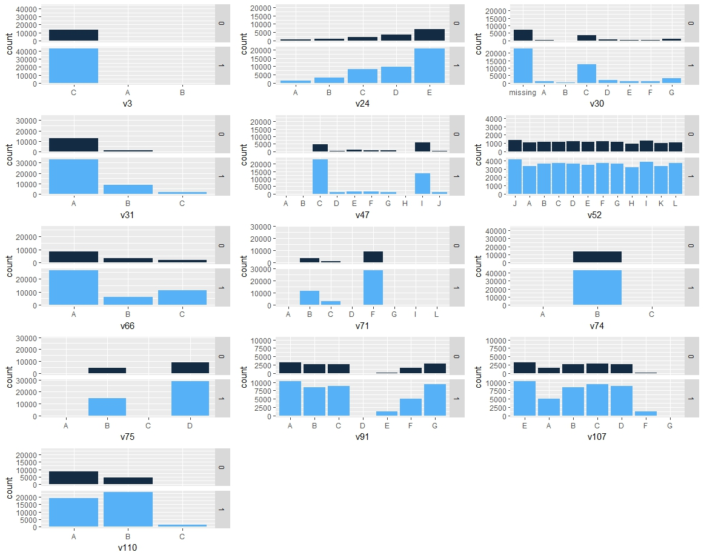
Data Exploration: Histograms
Distribution of categorical variables:
v3, v24, v30, v31, v47, v52, v66, v71, v74, v75, v91, v107, v110

Slide 10
Data Exploration: Correlation, zero variance
Correlation analysis
Generated correlation matrix for remaining 12 numeric variables
Using pairwise absolute correlation cutoff of 0.75, identified 4 correlated variables: v10, v14, v34, v40
Zero and near-zero variance, using caret package
No variables exhibited zero variance
3 variables exhibit near-zero variance (<10%)
 | freqRatio | percentUnique | zeroVar | nzv
v38 | 52.42693 | 0.020994 | FALSE | TRUE
v3 | 504.6549 | 0.005248 | FALSE | TRUE
v74 | 153 | 0.005248 | FALSE | TRUE

Slide 11
Feature Selection: Information Value
The use of information value (IV) and weight of evidence (WOE) is popular screening method for selecting predictor variables for binary classifier models
Used extensively for credit scoring, classifying loan repayment probabilities
Facilitates the consideration of each variable’s independent contribution to the outcome
Enables the comparison between continuous and categorical variables without the need to create dummy variables
By convention, the values of the IV statistic can be interpreted by the following table:
Information Value | Variable Predictiveness
< 0.02 | Not useful for prediction
0.02 to 0.1 | Weak predictive power
0.1 to 0.3 | Medium predictive power
0.3 to 0.5 | Strong predictive power
> 0.5 | Suspicious predictive power

Slide 12
Feature Selection: Information Value
Numeric + Categorical Variables
Variable | IV
v50 | 0.467982813
v31 | 0.226882245
v129 | 0.177234292
v47 | 0.160790125
v62 | 0.157678475
v110 | 0.152982998
v66 | 0.129938822
v12 | 0.09030852
v21 | 0.088635846
v38 | 0.049081143
v114 | 0.032781355
v72 | 0.031632212
v30 | 0.013698502
v24 | 0.011741035
v71 | 0.007115383
Using the Information package, IV was calculated for numeric variables alone as well as numeric and categorical variables combined
Numeric Variables
Variable | IV
v50 | 0.46078426
v129 | 0.17578331
v10 | 0.16512801
v62 | 0.15019944
v14 | 0.13765286
v12 | 0.08555659
v21 | 0.08513701
v34 | 0.05674745
v38 | 0.05434840
v114 | 0.03370896
v72 | 0.02830984
v40 | 0.01364609

Slide 13
Logistic Regression Models
Logistic regression is suitable for describing a relationship between a binary response variable and independent predictor variables
Models were built using variables with medium and strong predictive power by IV scoring (IV 0.1 – 0.5)
Model Name | Description | Variables
Log5Num | Numeric variables only, before correlation analysis | v50, v129, v62, v10, v14
Log3Num | Numeric variables only, after correlation analysis | v50, v129, v62
Log8NumCat | Numeric and categorical variables, before correlation analysis | v50, v31, v129, v10, v47, v62, v14, v66
Log6NumCat | Numeric and categorical variables, after correlation analysis | v50, v31, v129, v47, v62, v66
Log5aNumCat | Numeric and categorical variables, after correlation analysis | v50, v31, v129, v62, v66
Log5bNumCat | Numeric and categorical variables, after correlation analysis | v50, v31, v129, v47, v66
Log4NumCat | Numeric and categorical variables, after correlation analysis | v50, v31, v129, v66

Slide 14
Model Evaluation
AUC on validation set
Log loss ranking of test set predictions on Kaggle website
Model Name | Variable Significance | AUC | Kaggle Score | AUC Rank | Kaggle Rank
Log5Num | *** v50, v129, v14 * v10 . v62 | 0.69863 | 0.50538 | 7 | 6
Log3Num | *** v50, v129 ** v62 | 0.69905 | 0.50545 | 6 | 7
Log8NumCat | *** v50, v31B, v31C, v14, v66B, v66C ** v129 v10, v47, v62 | 0.72705 | 0.48858 | 2 | 1
Log6NumCat | *** v50, v31B, v31C, v66B, v66C ** v129 v47, v62 | 0.72703 | 0.48864 | 3 | 3
Log5aNumCat | *** v50, v31B, v31C, v129, v66B, v66C * v62 | 0.71939 | 0.49324 | 4 | 4
Log5bNumCat | *** v50, v31B, v31C, v66B, v66C ** v129 v47 | 0.72707 | 0.48860 | 1 | 2
Log4NumCat | *** v50, v31, v129, v66 | 0.71937 | 0.49335 | 5 | 5

Slide 15
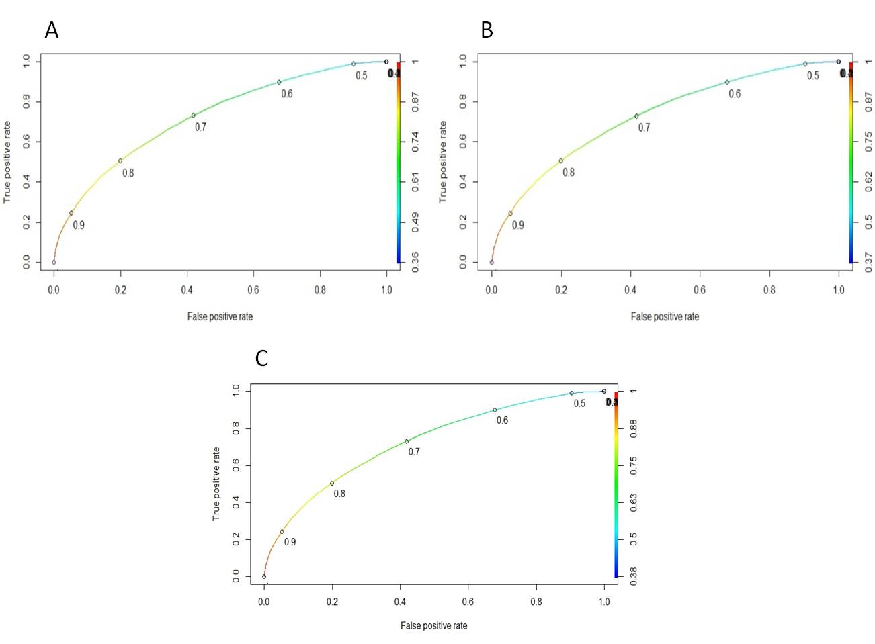
Model Evaluation
AUC Top 3 models :
Log5bNumCat 0.72707
Log8NumCat 0.72705
Log6NumCat 0.72703
Kaggle Top 3 models:
Log8NumCat 0.48858
Log5bNumCat 0.48860
Log6NumCat 0.48864

Slide 16
Model Evaluation
Log8NumCat contains highly correlated variables.
Discard in favour of Log6NumCat and Log5bNumCat
A logistic regression model is said to have a better fit to the data if it can demonstrate a statistically significant improvement over a model with fewer predictors.
Log6NumCat and Log5bNumCat differ by a single variable: v62
Performed likelihood ratio test to determine if observed difference was significant
p-value of 0.1504 = therefore, Log6NumCat does not have a statistically significant improvement over Log5bNumCat
Log5bNumCat is the best model for predicting accelerated claims
v50, v31, v129, v47 and v66

Slide 17
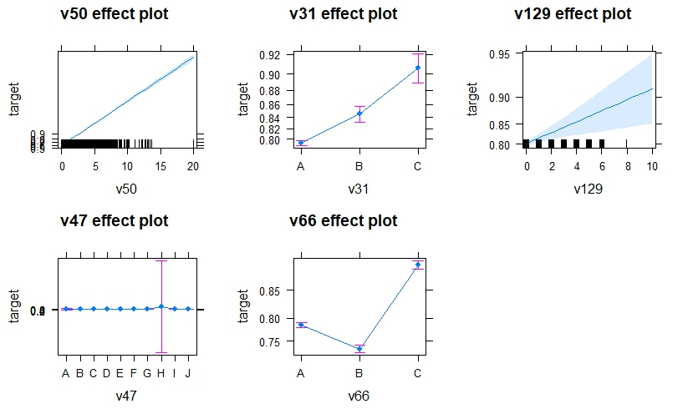
Model Usage
Using model Log5bNumCat, the predicted probability of an accelerated claim can be graphically represented, given a value for each predictor

Slide 18
Future Directions
Target ratio imbalance
k-fold cross validation
Explore missing values predictor capabilities
Compare outcome to decision tree models

